Slide 1
Smart Healthcare Appointment
Class Diagram

Slide 2
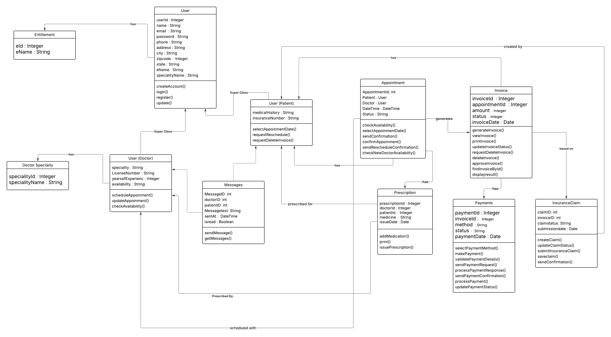
Smart Healthcare Appointment (Class Diagram)

